Slide 1

SYSTEM DEVELOPMENT FOR MARKETING
RECOMMENDER SYSTEMS USING COLLABORATIVE FILTERING METHODS
(KNN & SVD)
David Andrew
Student No. 500903075

Slide 2
About the Dataset
The Netflix Prize dataset is a large dataset of movie ratings that was released by Netflix in 2006. The dataset consists of about 100,000,000 ratings for 17,770 movies given by 480,189 users1. Each rating in the training dataset consists of four entries: user, movie, date of grade, grade. Users and movies are represented with integer IDs, while ratings range from 1 to 51. The goal of the Netflix Prize was to develop a recommendation algorithm that could predict user ratings for movies and TV shows with greater accuracy than Netflix’s existing algorithm, Cinematch2. Meanwhile the Jester Dataset was about 140 Jokes rated by 59,132 users.

Slide 3
Business Question & Sub-questions.
“How can we improve the customer experience be improved by recommending products or services that they are likely to enjoy?”
Sub Research questions
What are the most effective algorithms and techniques for building a recommender system for the Netflix users ?
What are the most effective algorithms and techniques for predicting user ratings based on the Netflix Prize dataset?
How can we evaluate the accuracy and effectiveness of different recommender system algorithms using the Netflix Prize dataset?
How Similar are the users in terms of their feeling towards a particular movie</br>
</div>

Slide 4
DATA PREPARATION & CLEANING STEPS
NETFLIX DATASET
Merged all the movie rating files and movie title file using the MovieID as reference.
Default dataframe shape(100480507, 6)
Dropped rows with missing values from in the ‘release year’ column.
Dropped “Title” column because its not needed for analysis
Sample dataframe of 500 movies shape (2798704, 5)
Checked duplicates
JESTER DATASET
Merged the Jesting ratings and items dataset using jokeId as reference.
Default Dataframe shape (1761439, 4)
Changed negative variables to positive and removed duplicates.
Reduced the integer datatypes to smaller dimensions to save RAM.

Slide 5
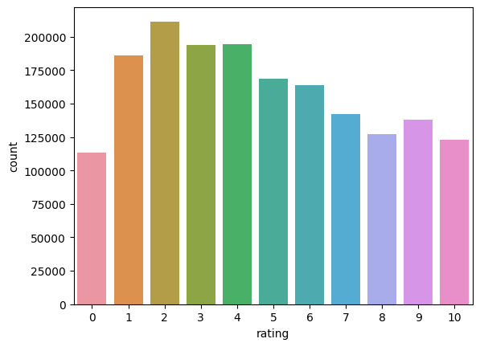
EXPLORATORY DATA ANALYSIS
JESTER DATASET.
Distribution ratings were normally distributed
No correlation between the user, Jokes and ratings
Fig. 1

Slide 6
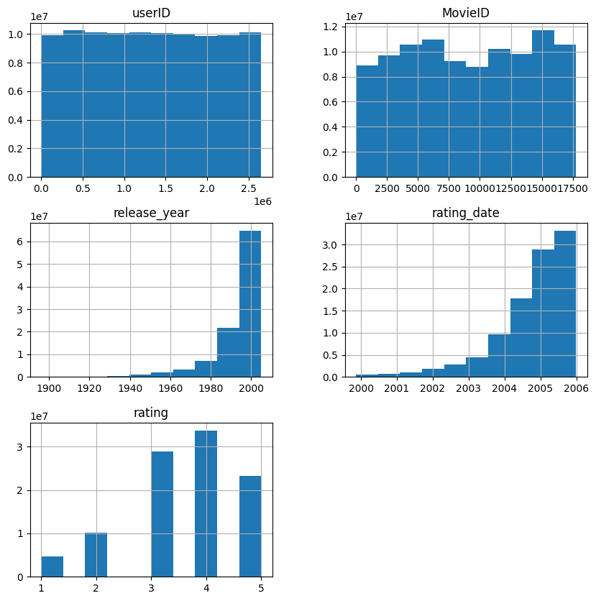
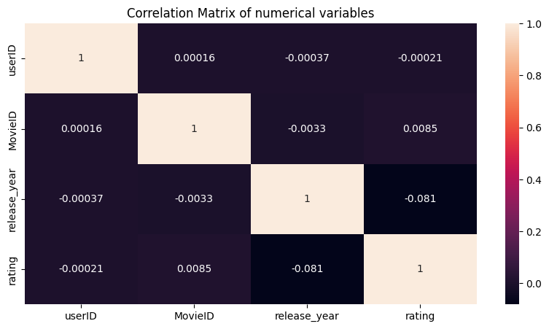
EXPLORATORY DATA ANALYSIS
NETFLIX DATASET
The Distribution of the ratings were skewed toward the higher ratings.
Number of Ratings were higher from 2004.
Each user rated approximately 300 movies at least once.
No correlation was found.
Fig. 3.
Fig. 2

Slide 7
RMSE Validation
1.054 - Netflix
RMSE Test
1.084 - Netflix
KNN Steps (Applies to both Datasets)
Used the Sklearn library to train the model to use as baseline for Hyperparameter tuning.
Conducted Hyperparameter tuning on train_sparse_matrix and used best parameters to fit the updated model on the fitted dataset.
Tried the model on the validation set and computed RMSE
Tested the model on the test set and successfully recommended the nearest neighbour of a USER.
Checked for accuracy of the model on the TEST set using the RMSE.
RMSE Validation
3.02 - Jester
RMSE Test
2.95 - Jester

Slide 8
RMSE Validation
0.9885 - Netflix
RMSE Test
0.9918 - Netflix
SVD Steps (Applies to both Datasets)
Used the Surprise library to read the dataset & train the model to use as baseline for Hyperparameter tuning.
Split the dataset into train and test
Fit the SVD algorithm on the dataset and did cross validation
Trained the svd model and tested on the test set
Checked for accuracy of the model on the TEST set using the RMSE.
Successfully recommended the nearest neighbour of a USER.
.
RMSE Validation
2.5156 - Jester
RMSE Test
2.5146 - Jester

Slide 9
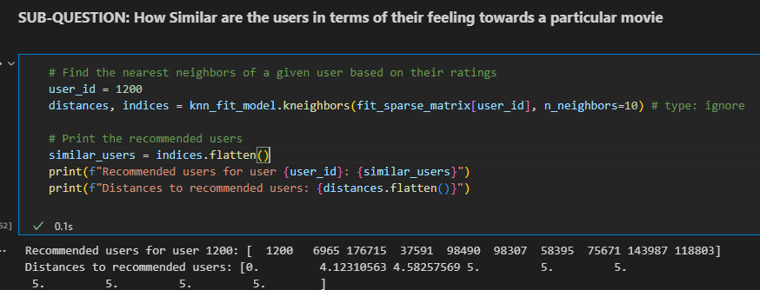
KNN Recommendation Example
Fig. 4.

Slide 10
Results Analysis
The results revealed that the KNN algorithm had an RMSE value of 1.01, while the SVD had 0.9. This suggests that SVD performed better in terms of accuracy than KNN. The SVD Similarly performed better on the Jester Set..
KNN is slower than SVD due to its pairwise distance calculation, making it computationally expensive for large datasets. On the other hand, SVD factorizes user-item matrices and computes latent factors more efficiently, making it faster for large and sparse datasets like the Netflix Dataset
SVD showed to be more precise in terms of accuracy and may be a preferable option when efficiency is important. Finally, the algorithm you use is determined either by precise requirements of your project.
Based on the scope of this report, SVD can help better improve the customer experience of Netflix users using SVD. This is also evident as Simon Funk help popularize this method in the Netflix prize (see https://surprise.readthedocs.io/en/stable/matrix_factorization.html#surprise.prediction_algorithms.matrix_factorization.SVD)

Slide 11
Limitations
Netflix dataset was too large and computationally demanding.
Longer loading and wait time for code execution thus was unable to use population sample of Netflix dataset.
Sparse matrix had many index errors.
SVD is more difficult to interpret than KNN.

